Slide 1
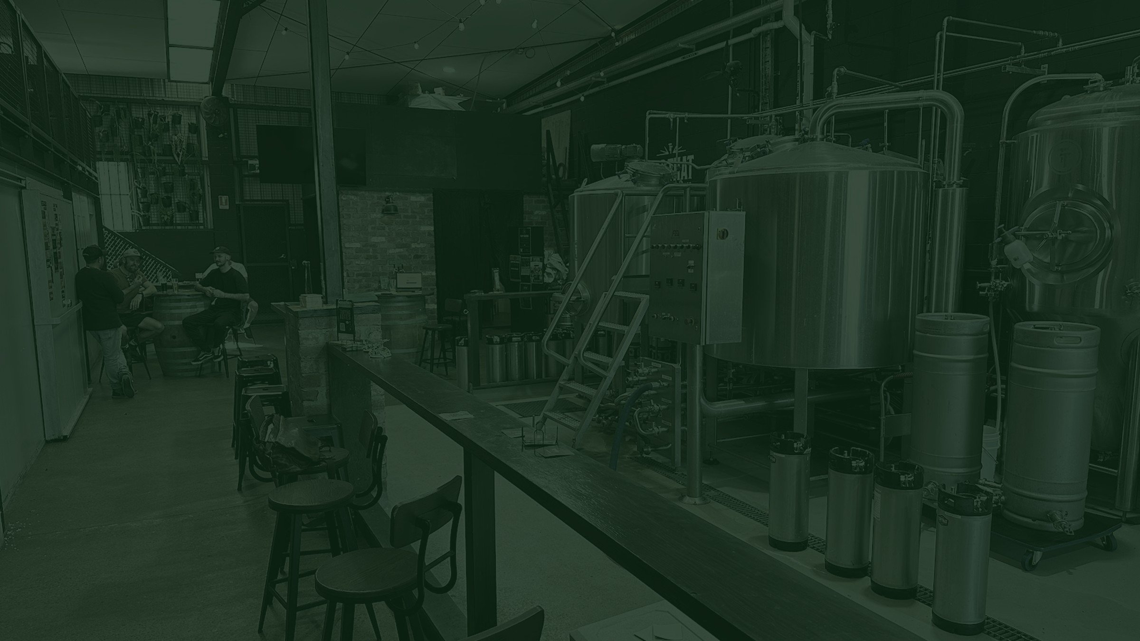

TAP THAT
THE PIVOT
From vanity to sanity. A strategic evolution, not a rebrand.
Prepared by Jewell Projects for the founders of Tap That
Notes:
The plan is sound. The shape is the problem, and that is a much better problem to have. Everything after this slide is about focus.

Slide 2
WHAT WE SAW AND HEARD
The overall plan is sound. Focus and shape is the unlock.
1
The strategy is sound, the shape is not
2
Two business units cancelling each other out
Insightful, comprehensive, and Justin's mental model that everything feeds refills is spot on.
But it reads as AI theoretical: too much equivalence, too many directions, and its own best insights are buried.
Thought to be complementary, in reality pulling opposite ways. A great refill business takes traffic out of the Tap Room.
Which means more spend to replace it, at a high cost per customer.
3
The weakest unit is getting the support
4
The offer is good, but the stars cannot shine
Refills are at MVP, and only refills, and only beer.
Marketing's time goes to propping up the unit that does not work, at the cost of the ones that do. Watering the weeds, not the flowers.
We suspect a long tail of beer options is driving cost of goods.
And we think it is causing choice paralysis at the point of sale.
5
Chasing two rabbits, catching neither
6
In danger of dying with a beautiful corpse
For all the right reasons, marketing explores an idea, quits, moves on.
Nothing gets the run it needs to prove itself either way.
Running a brewery is hard. Hospitality is harder. Both on a skeleton staff is unreasonable.
Permission is needed to reshape the business.
Notes:
Six findings. The second one is the whole deck: the two units cancel each other out.

Slide 3
THE CORE READ
TAP ROOM IS VANITY.
REFILLS ARE SANITY.
96-113
56%
20%
Active refill customers, ordering repeatedly. That is MVP status, reached without a push.
of refill customers bought their tap system somewhere else. The refill proposition is already validated.
of system buyers are said to have visited the Tap Room. That is correlation, not proven causation.
The Tap Room works as an event and function destination. It does not work as a walk-in, because the footfall is not there. The task now is to brutally edit the losers and invest in what is proven.
Notes:
96-113 active refill customers, reached without a push. That is the proof the model works. The 20% is the number to be careful with.

Slide 4
WHERE TO FROM HERE / CORE
Get the core right, then go for more.
1
2
3
4
5
Tap Room:
Pause and pivot
Convert the owners
already sold
Remove all friction
in refills
Rationalise
the range
Ride the
wellness wave
Pause walk-in trading. Go all in on destination demand.
Objections are already overcome for existing kegerator owners.
Every extra step in the refill process costs a sale.
Create hero products, cut the non-productive tail.
Also the way back to lapsed customers.
PROOF Event and function nights are already profitable
PROOF 56% bought their system elsewhere
PROOF 10% reorder monthly, 40% far later. One clock fails both
PROOF About 19 brew choices loses both curation and best-in-class
PROOF 40% of lapsed customers cite cutting back
PR to tourism, event and wedding planners
Own the tour circuit: Urban Legends booking tool, Pineapple Tours, Crafted award callout
Ticketed events and collabs
Party rental, with minimum-guarantee kegs covering the rental cost
Harvey Norman gift-with-purchase and point-of-sale tie-up, plus buyer database
Buy Kegland and corny-keg owner databases
Official Benchy partnership and database
Co-branded outdoor BBQ and system bundle
Free delivery always works, recover margin in dollars, not percent
Replace the blanket 90-day SMS with consumption-triggered reminders
Lead on the simplicity: no CO2, pick up and go
Simplify membership, refill-centric
Get Justin off the bar and onto the road
Deeper product marketing on the brews that remain
Introduce social proof cues, such as most popular
Free the shelf space and the brewing time for the heroes
Low, non-alcoholic, low-carb and protein range
Wellness influencer collabs, amplify or co-develop
Reframe for the cutting-back cohort as a healthier alternative, not less beer
Notes:
Five moves, in order. One and three are the ones that change the shape of the business.

Slide 5
WHERE TO FROM HERE / MORE
Once the core is running, extend it.
6
7
8
9
10
Full press
on wholesale
Design
for her
Hyper-personalise
comms and LTV
Make the kegerator
worth writing about
Package around
the duopoly
Resourced, structured and measured. No more falling through the cracks.
Covered is not the same as catered for.
This needs a process, not a message.
Turn the system itself into desire.
Locked-in venues still have real pain points.
PROOF One wholesale account is worth about ten households
PROOF The passion for brews is real, the range does not reflect it
PROOF Buying cycle: about 60% within three months, 40% longer
PROOF 1,000 giveaway entries is proven demand
PROOF Contractual lock-in is not the same as satisfaction
Hire a full-timer or an agent
Set targets and KPIs
Custom systems for sporting clubs, minimum-guarantee kegs per season
Move rigs from footy to cricket for year-round occupancy
Romance the RTD properly
Build the hydration story through the wellness and light range
Products she is proud to serve
Systems designed to sit in eyesight at home
Track consumption to predict the next refill
Re-engage lapsed customers by actual reason: cutting back versus forgot
Trigger-based outreach, not calendar-based
Personal details: anniversaries, footy finals
User-generated content mechanic: tag Tap That, get a discount
Own your keg personalisation, like a whisky bottle
Explore short-term and occasion rental for parties
A packaged offer that works around existing contracts
Find the judo move that uses their size against them: no lock-in, profit share, white labelling
Notes:
These only work once the core five are running. Six is the one with the best return per hour.

Slide 6
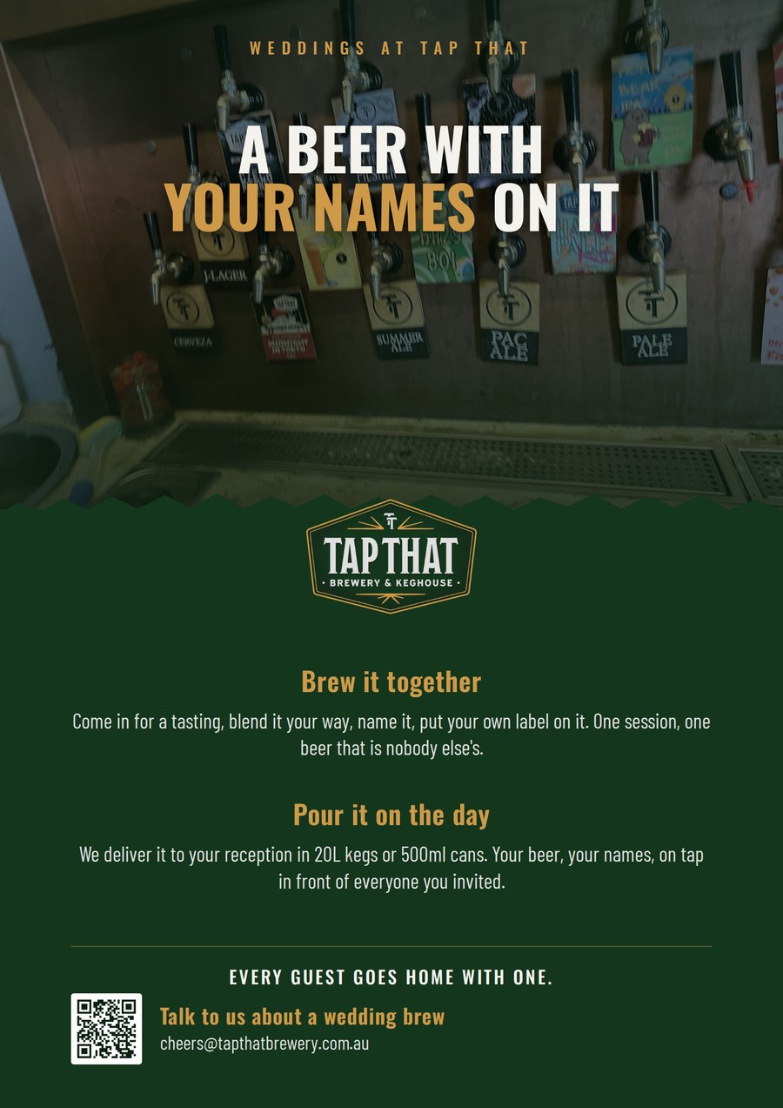
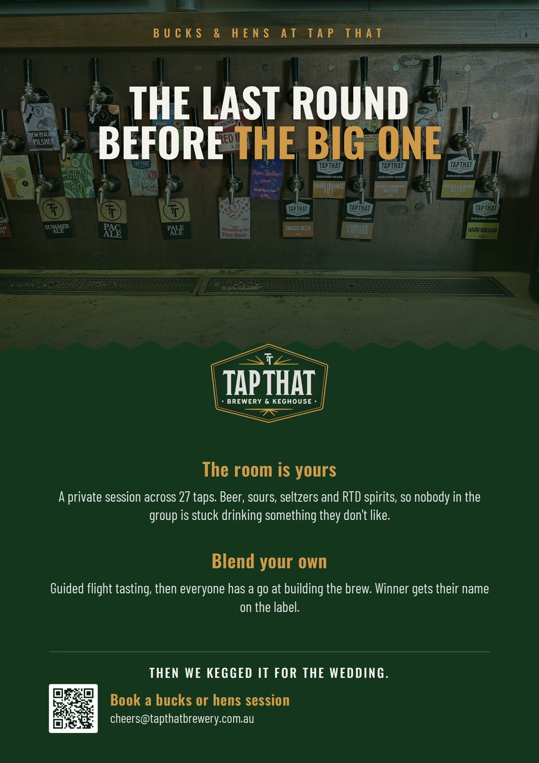
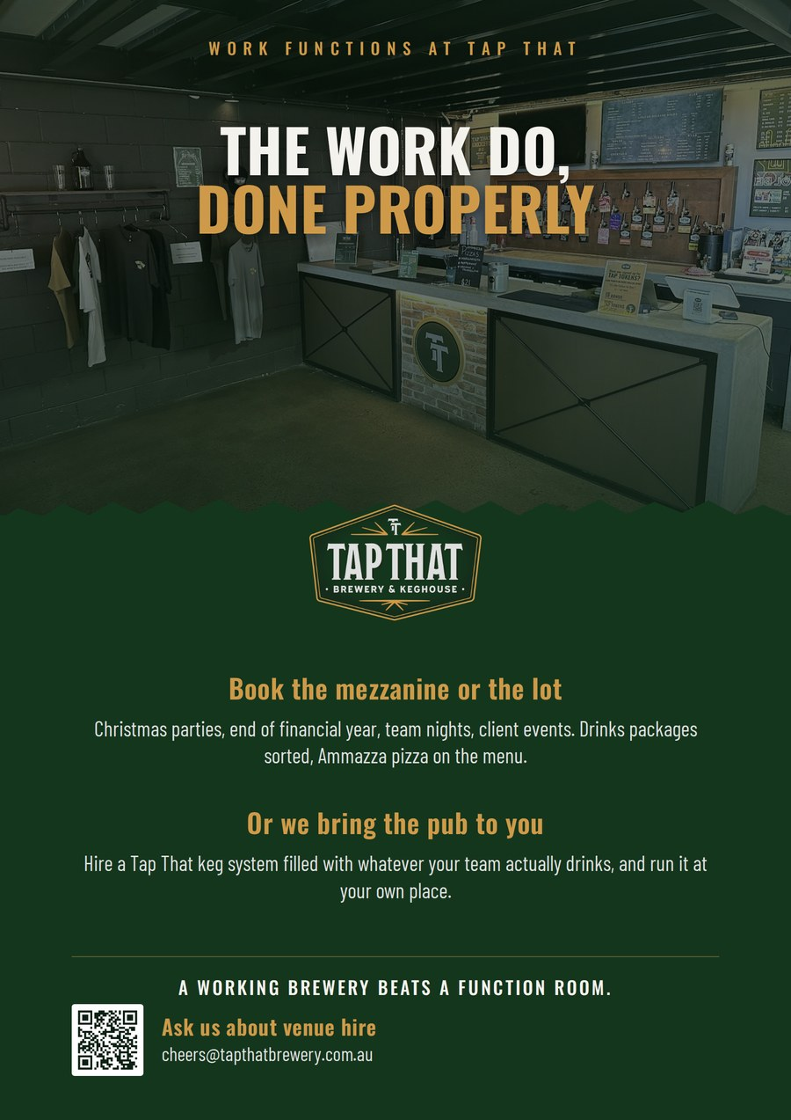
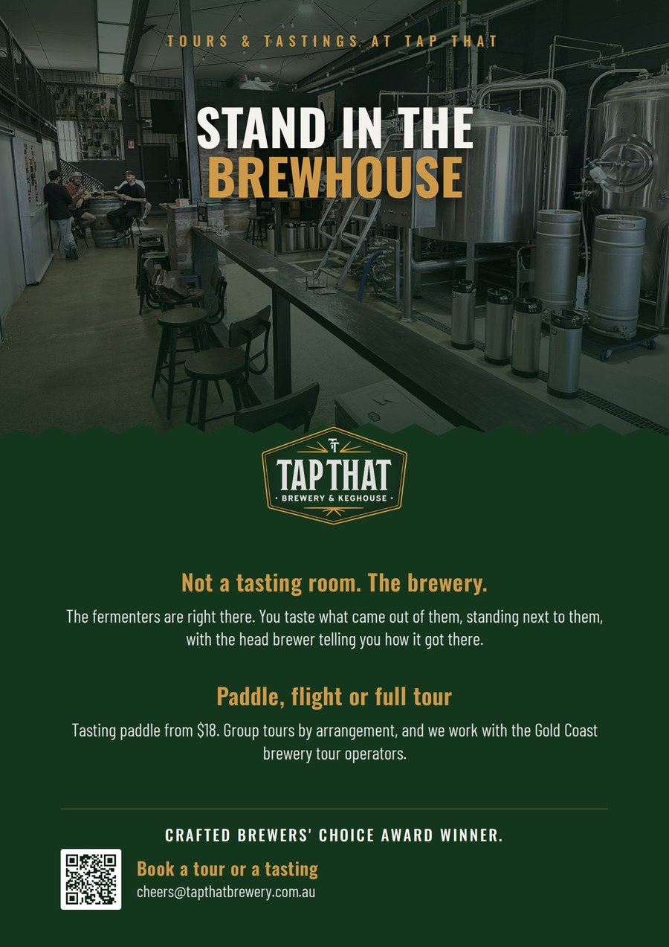
EVENT EXAMPLES
The destination business, sold the way the venue already sells it.
Weddings
Bucks and hens
Work functions
Tours and tastings
Format taken from Tap That's own in-venue flyer. Photography is the August site visit, not stock. Print-ready A4 at 200 dpi.
Notes:
These replace the two flyer artworks in the earlier draft. Those were embedded as EMF vector, which renders blank anywhere other than PowerPoint on Windows. These are 200 dpi PNG, print-ready at A4.

Slide 7

B2C FLYWHEEL / THE SIGNATURE WEDDING BREW
Turning hens and bucks days into wedding day volume.
1
The Tap Room event
High-margin function revenue
Captures premium venue hire and group tasting packages upfront.
Private hens or bucks session. Guided flight tasting across 27 taps with interactive ingredient blending.
2
Bespoke branding
Co-branded custom label, naming, and beverage style selection: beer, sour, seltzer or RTD spirit.
Guaranteed bulk volume
Secures pre-sold beverage volume for the reception.
3
Wedding day reception
Bulk supply delivered in 20L kegs or custom cans for the main event.
Organic customer acquisition
Converts guests into hardware and subscription leads.
4
Take-home flywheel
Every wedding guest goes home with a branded sample and a QR code.
The artwork, ready to send
THE ECOSYSTEM EFFECT Every wedding is a live, self-funding brand activation that puts Tap That product into the hands of 100 or more targeted consumers.
Notes:
The left-hand column used to be a wireframe of a can and a keg. It is now the flyer that would actually go out.

Slide 8
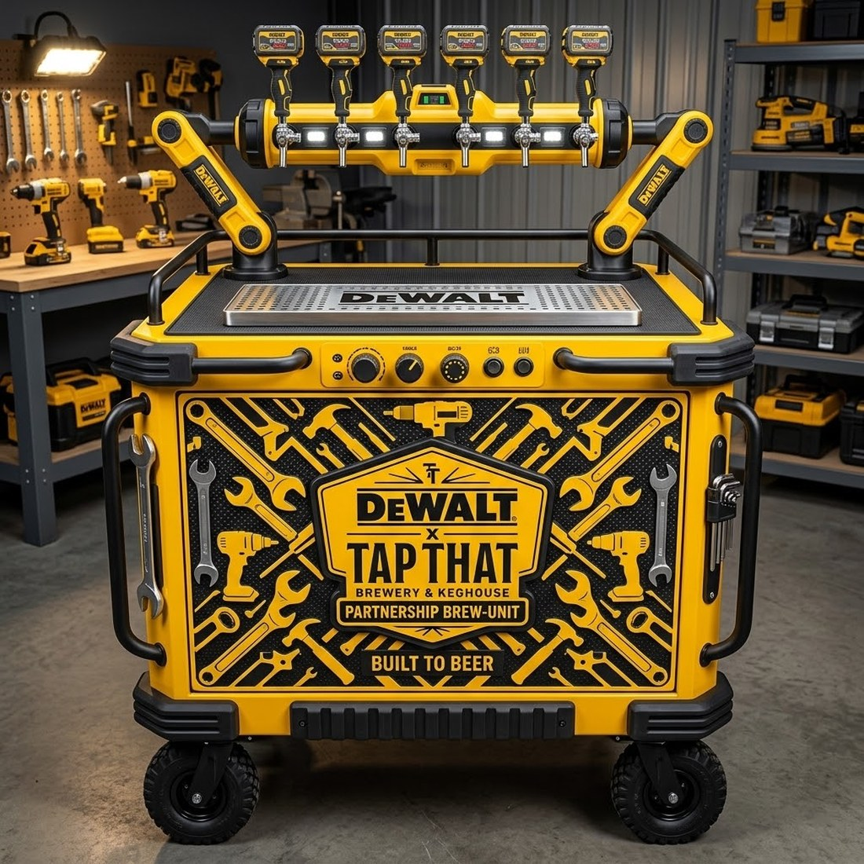
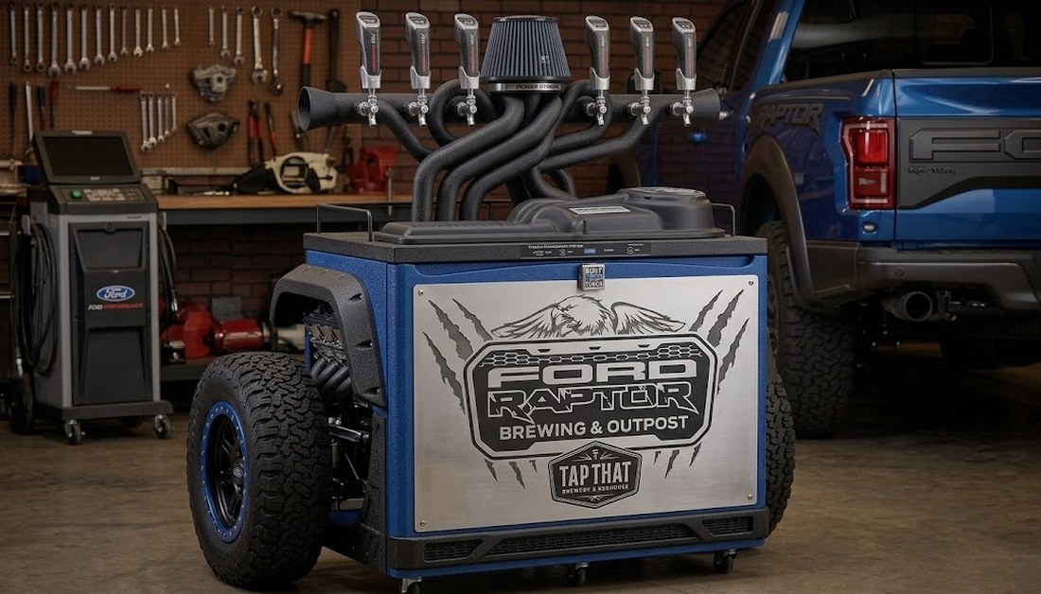
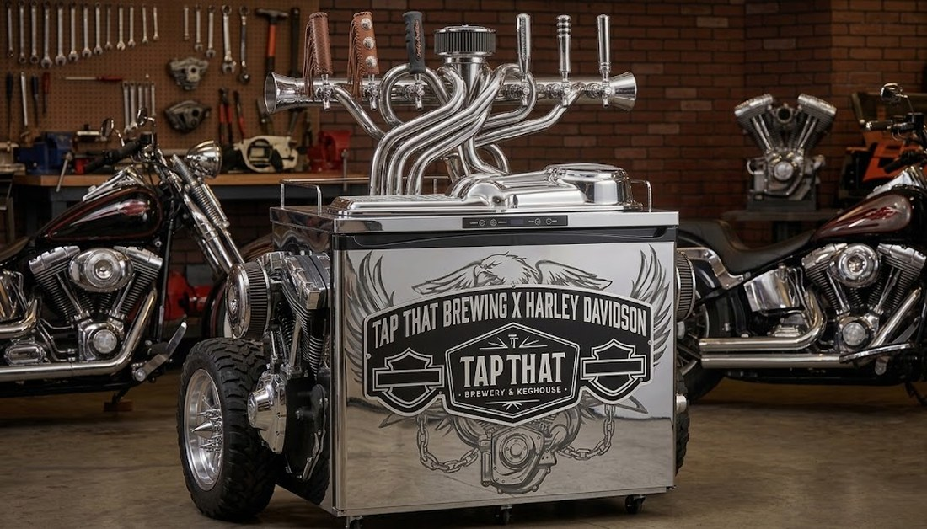
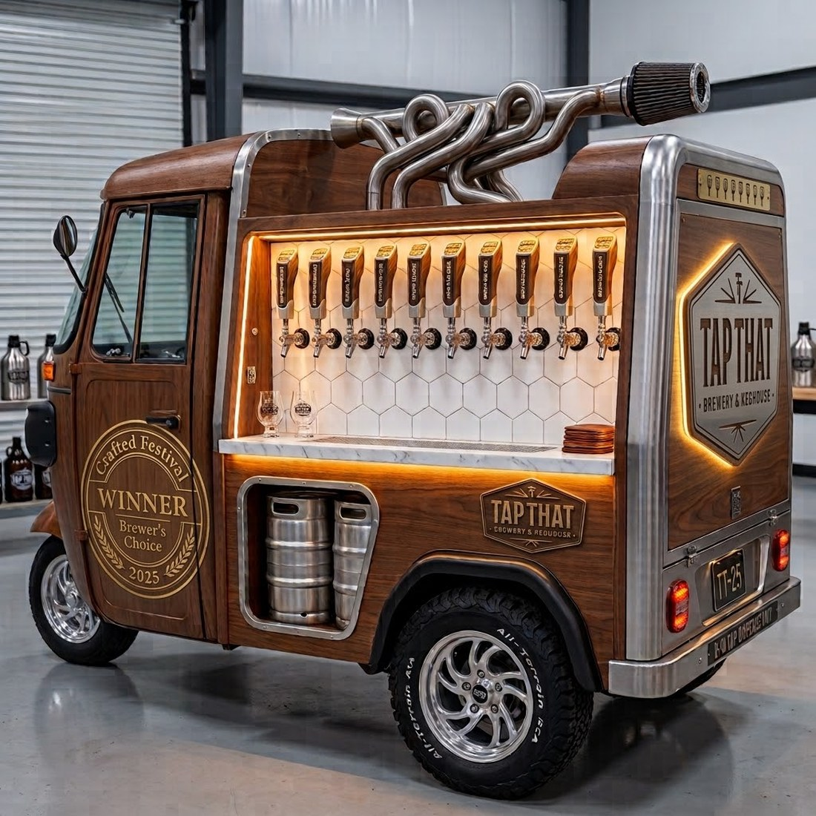
PARTNERSHIP CONCEPTS
What a co-branded system could look like.
Trade and worksite
Four-wheel drive and touring
Motorcycle clubs
Mobile bar for events
Concept renders for discussion. No approach has been made to any brand shown, and none of these marks are licensed.
Notes:
Concepts only. Nobody has been approached, and the marks are not licensed. Worth showing because the reaction to them tells you which partnership is worth chasing first.

Slide 9
OTHER STRATEGIC NOTES
Two things to hold on to.
Who is the real enemy?
Overpriced pubs. Not the duopoly, not A&A, not the keg-delivery operators. Speak in unit economics everywhere, and do not get pulled into a keg price war you do not need to fight.
Handle the census with care
49 people, forced-choice answers. People do not always know, or say, why they buy. Status, wanting to be seen as successful, compensating for something else: real drivers, rarely spoken. Useful colour. Not a strategy map.
Notes:
The census is 49 people answering forced-choice questions. It is colour, not a map.

Slide 10
HOUSEKEEPING / WEBSITE AND BRAND
Small fixes, disproportionate impact.
1
Above the fold
No hook, background film cut too fast to read, copy pollution, low-resolution static logo.
2
Missing proof
The Crafted Brewers' Choice award, the fits-any-system callout and strong reviews are all buried below the fold.
3
Hierarchy
Four business units treated equally. Prioritise the moments that matter: family, friends, the proud provider role.
4
Category
Commercial brewer invites mainstream price and product comparisons. It needs an elevated category name of its own.
5
Channel language
Wholesale should speak directly to restaurants and sporting clubs: cuisine matching, club-branded kegs, straight to the margin story.
Notes:
None of these is a big job. All of them are being paid for daily in conversion.

Slide 11
WHERE JEWELL PROJECTS CAN HELP
What we can pick up from here.
FROM THE BRIEF
ALSO WORTH ADDING
Website design optimisation
Trigger-based CRM and lifecycle build, which fixes the 90-day SMS problem
SEO and GEO best-practice implementation
Membership programme redesign
PR outreach to tourism operators and experiential platforms
Wholesale structure and KPI framework
Influencer outreach
Event flyer and campaign artwork, in the format shown
Partnerships outreach and project management: BBQ brands, system collabs
Urban Legends collaborative booking tool
Notes:
Left is what the brief asked for. Right is what we would add, and the CRM build is the one with the shortest payback.

